Slide 1
Service Mesh for Microservices

Slide 2





PROVISION, SECURE AND RUN ANY INFRASTRUCTURE
OSS TOOL SUITE
PRODUCT SUITE
Consul Enterprise Nomad Enterprise
RUN
Applications
Nomad
Consul
Vault Enterprise
SECURE
Application Infrastructure
Vault
Terraform Enterprise
PROVISION
Infrastructure
Vagrant
Packer
Terraform
FOR INDIVIDUALS
FOR TEAMS

Slide 3
Service Mesh for Microservices

Slide 4




Monolith
A
B
C
D

Slide 5
Monolith
A
B
C
D

Slide 6
Monolith
A
B
Static IP
C
D

Slide 7

Monolith
A
B
Static IP
LB
C
D

Slide 8
Monolith
A
B
Static IP
LB
C
D
DMZ Firewall
Zone Firewall

Slide 9
What Changed?

Slide 10
Monolith
A
B
C
D

Slide 11
Microservices
A
B
C
D

Slide 12
Microservices
A
B
?
C
D

Slide 13
Microservices
B
B
B
A
?
C
D

Slide 14
Microservices
B
B
B
A LB
C
D

Slide 15
Operating in the Cloud + Containers
Dynamic IP Addresses
Higher Failure Rate Ephemeral Infrastructure Complex Network Topology

Slide 16
Service Discovery

Slide 17

A
B
B
B
Register
Service Registry

Slide 18
A
B
B
B
Discover
Service Registry

Slide 19
A B
B
B
Connect
Service Registry

Slide 20

B
B
B
Attacker
Connect
Service Registry

Slide 21
Service Segmentation

Slide 22


Defining Segmentation
Network
Segment A
Segment B
Splitting network into sub-networks
Restricting communication between sub-networks Virtual LAN, Firewalls, Software Defined Networks
Coarse Grained, Many Services

Slide 23
Monolith
A
B
Static IP
LB
C
D
DMZ Firewall
Zone Firewall

Slide 24
Microservices
A
B
C
D

Slide 26
A
B
A -> B
C
D
C -> D
D -> C

Slide 27
A
B
C
D
A -> C
B -> D

Slide 29
Service Mesh for Microservices
Service Discovery. Connect services with a dynamic registry
Service Configuration. Configure services with runtime configs
Service Segmentation. Secure services based on identity

Slide 30
Consul Usage
Launched in 2014
12K+ GitHub Stars
1M+ Downloads monthly Customers running 50,000+ agents

Slide 31
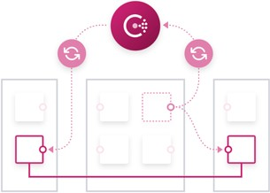
Service Discovery
Registry of Nodes, Services, Checks
DNS API HTTP API
Web UI

Slide 32



$ dig redis.service.consul
; <<>> DiG 9.8.3-P1 <<>> redis.service.consul
; (3 servers found)
;; global options: +cmd
;; Got answer:
;; ->>HEADER<<- opcode: QUERY, status: NOERROR, id: 9046
;; flags: qr aa rd; QUERY: 1, ANSWER: 1, AUTHORITY: 0, ADDITIONAL: 0
;; WARNING: recursion requested but not available
;; QUESTION SECTION:
;redis.service.consul. IN A
;; ANSWER SECTION:
redis.service.consul. 0
IN A 10.1.10.38

Slide 33
$ curl http://localhost:8500/v1/catalog/service/redis [
{
"ID": "52f73400-a352-80d2-9624-e70cc9996762",
"Node": "consul-client-2",
"Address": "10.0.1.83",
"Datacenter": "ServiceName": "ServiceTags":
"global", "cache"
],
"dc1",
"redis", [
"ServiceAddress": "10.0.1.83",
"ServicePort": "ModifyIndex":
…
24815,
31,

Slide 34
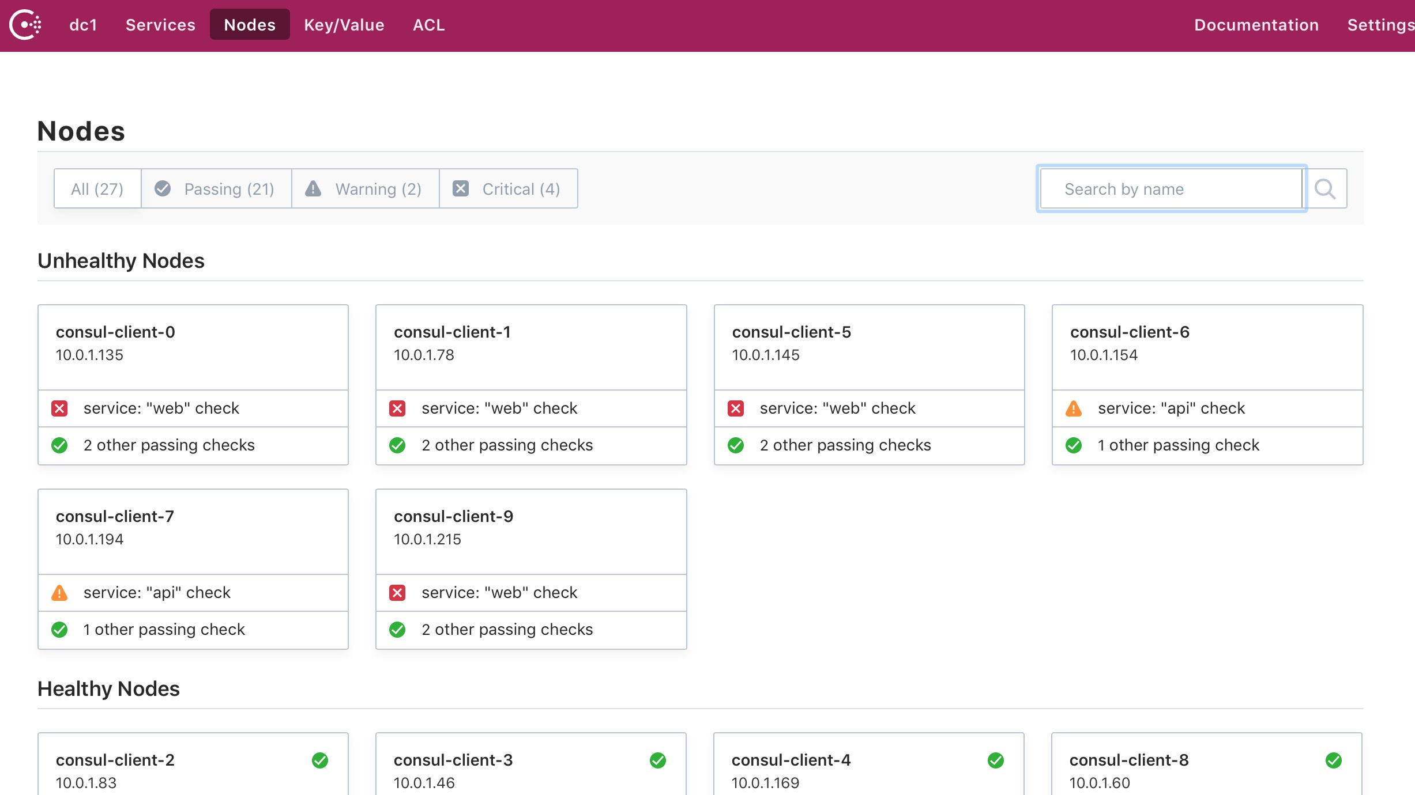

Slide 35
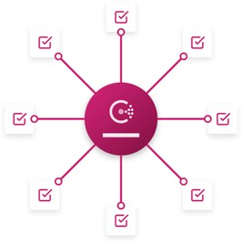
Service Configuration
Hierarchical Key/Value Store
HTTP API
Long-polling / Edge trigger Locking

Slide 36
$ consul kv put service/web/enable_foo true Put successfully!
$ consul kv get service/web/enable_foo true

Slide 37
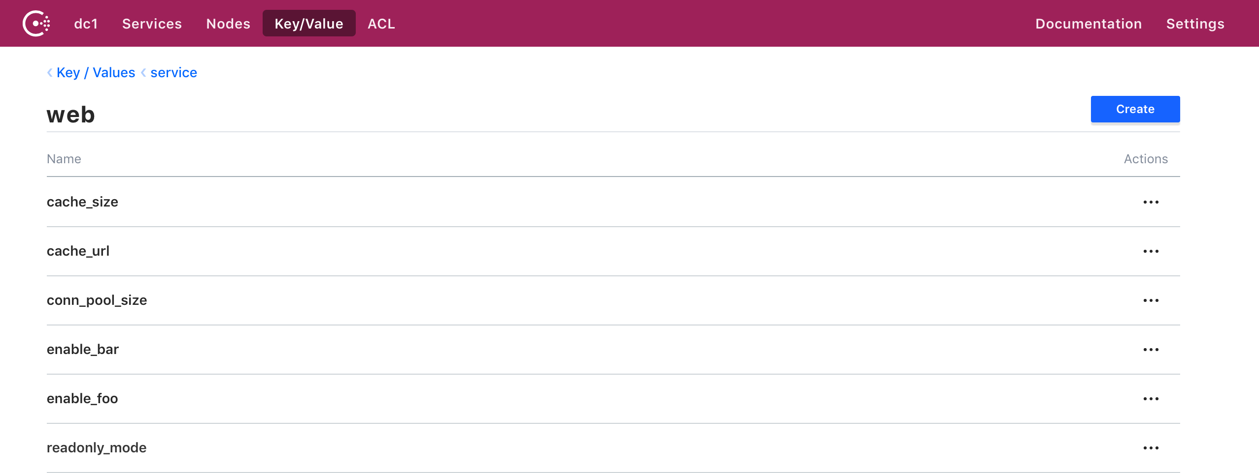

Slide 38
Consul Connect

Slide 39
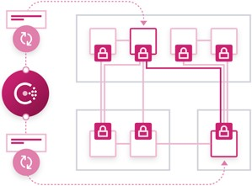
Consul Connect
Service Access Graph
Certificate Distribution Application Integration

Slide 40
Service Access Graph
Intentions to Allow/Deny Communication
Source and Destination Service Scale Independent
Managed with CLI, API, UI, Terraform

Slide 41
$ consul intention create -deny web '*' Created: web => * (deny)
$ consul intention create -allow web db Created: web => db (allow)

Slide 42
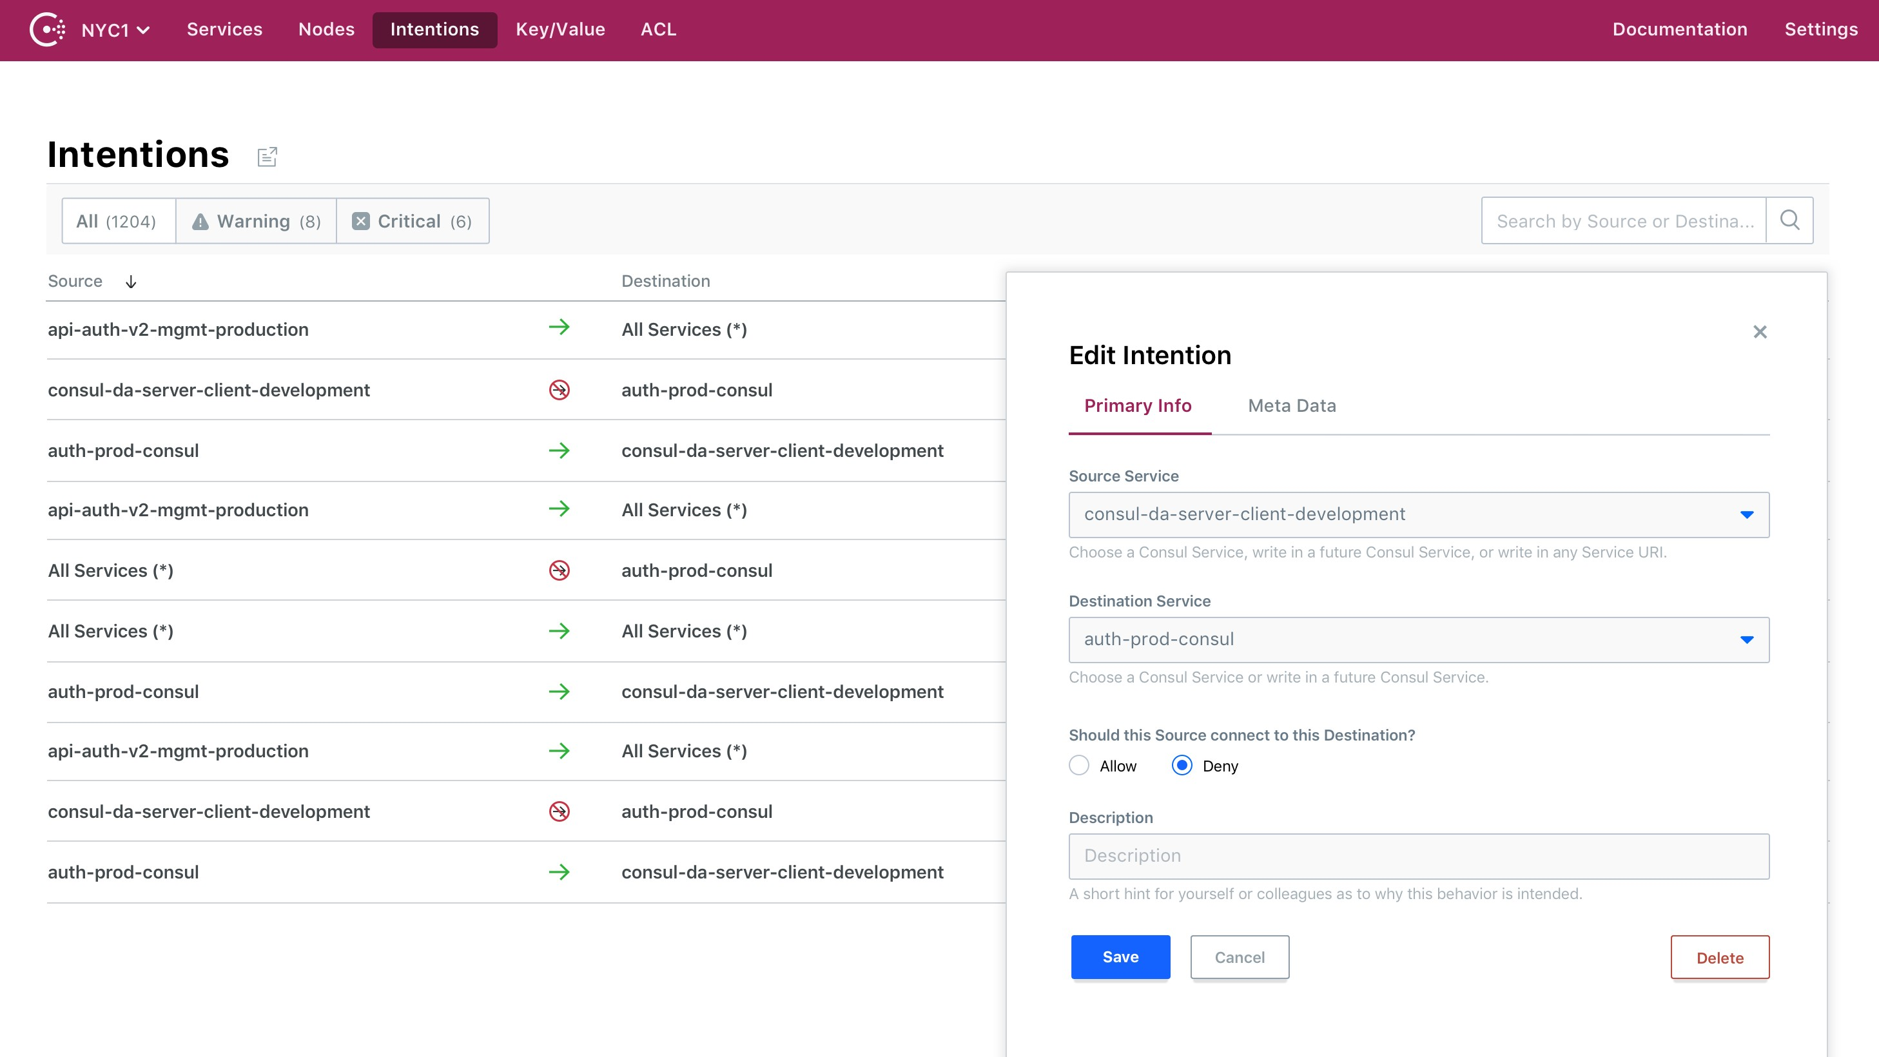

Slide 43
Certificate Distribution
Transport Layer Security (TLS)
Service Identity Encryption of all traffic

Slide 44



Certificate Generation
Automatic Generation & Rotation
Client
Server
Generate Key Pair
Certificate Signing Request
Sign Certificate

Slide 45



Certificate Authority Rotation
Root
Intermediary
Leaf

Slide 46


Certificate Authority Rotation
Root
Root
Intermediary
Intermediary
Leaf
Leaf

Slide 47

Certificate Authority Rotation
Root
Root
Intermediary
Intermediary
Intermediary
Leaf
Leaf
Leaf

Slide 48
Application Integration
Consul Client for Service Graph and Certificates
Sidecar Proxies Native Integrations

Slide 49
Sidecar Proxy Integration
No Code Modification
Minimal Performance Overhead Operational Flexibility

Slide 50


Sidecar Proxies
Client
Configure
Proxy
Proxy
Configure
Client
Connect
Connect
App
App

Slide 51

Pluggable Proxies
Client
Configure
Configure
Client
Connect
Connect
App
App

Slide 52



CO D E EDIT OR
{
"service": "web", "connect": {
"proxy": {
"config": {
"upstreams": [{
"destination_name": "local_bind_port": 1234
"redis",
}]
}
}
}
}

Slide 53
Connect to upstream redis
Client
Configure
Proxy
Connect localhost:1234
App

Slide 54
$ consul connect proxy \
-service web \
-upstream postgresql:8181
$ psql -h 127.0.0.1 -p 8181 -U mitchellh mydb
>

Slide 55
Native Integration
Standard TLS
Negligible Performance Overhead Requires Code Modification

Slide 56
// Create a Consul API client
CO D E EDIT OR
client, _ := api.NewClient(api.DefaultConfig())
// Create an instance representing this service.
svc, _ := connect.NewService("my-service", client) defer
svc.Close()
// Creating an HTTP server that serves via Connect server := &http.Server{
Addr: ":8080",
TLSConfig: svc.ServerTLSConfig(),
// ... other standard fields
}
// Serve! server.ListenAndServeTLS("", "")

Slide 57
Consul Connect
Service Access Graph. Intentions allow or deny communication of logical services.
Certificate Distribution. Standard TLS certificates with SPIFFE compatibility.
Application Integration. Native integrations or side car proxies.

Slide 58
Consul Architecture

Slide 59
Deployment
Single Binary
Server and Client Agents
3-5 Servers per Datacenter Multi-Datacenter Support

Slide 60


Consul Servers
Leader
Replicated State, Automatic Failover
Service Registry Service Access Graph Key/Value Store
Multi-DC Forwarding
Replication
Follower
Follower

Slide 61

Consul Clients
Server(s)
Expose HTTP and DNS API
Transparently Forward Register and Monitor Services Cache Service Graph
Client

Slide 62
Cluster Awareness
Server
Lightweight Gossip (Serf)
Cluster Membership Failure Detection
Gossip
Client
Client

Slide 63
Cluster Membership
Server
Server
Join Requires Any Peer
Server Discovery Protocol Versioning
New Server
Client
Client

Slide 64

Failure Detection
Server
Leaving vs Failing
Automatic Reaping No Heart beating
Failed Client
Client
Client

Slide 65
Datacenter
RPC
Leader
Follower
Replication
Gossip
RPC
Client

Slide 66
Datacenter
Datacenter
RPC
RPC
Leader
Follower
RPC
Leader
Follower
Replication
Replication
Gossip
Gossip
RPC
Gossip
RPC
Client
Client

Slide 67


Control Plane vs. Data Plane
Control
Consul as Control Plane
Pluggable Proxies as Data Plane
Configure
Data
Data
Communicate

Slide 68
Data Path
Client
Configure
Proxy
Proxy
Configure
Client
Connect
Connect
App
App

Slide 69

Consul with Containers
Consul Agent per Host
DaemonSet with Kubernetes Proxy per Container / Pod

Slide 70
Consul Architecture
Batteries Included
Highly Available & Scalable Pluggable Data Plane

Slide 71
Common Challenges
Infrastructure is means to an ends
Microservices Architecture Operational Challenges

Slide 72
Patchwork Solutions
Re-invent the wheel
Long Term Maintenance
Minimum Viable vs Maximum Utility

Slide 73
Service Mesh for Microservices
Service Discovery. Connect services with a dynamic registry
Service Configuration. Configure services with runtime configs
Service Segmentation. Secure services based on identity

